Slide 1

iFood CRM Data Analyst Case
Akinloye Olatunbosun Magbagbeola
loyemagba@outlook.com

Slide 2
iFood is a food delivery app in Brazil, present in over a thousand cities Their products includes wines, rare meat products, exotic fruits, specially prepared fish and sweet products which can be further divided into gold and regular products Customers can order and acquire products through 3 sales channels: physical stores, catalogs and company's website
DESCRIPTION

Slide 3
The company wants to build a predictive model that will produce the highest profit for the next direct marketing campaign A pilot campaign involving 2,240 customers was carried out, they were selected randomly and contacted by phone. Those who bought the phone were properly labeled. The total cost of the sample campaign was 6,720MU and the revenue generated by the customers who accepted the offer was 3,674MU. Globally, the campaign had a profit of –3,046MU and the success rate of the campaign was 15%. The objective is to develop a model that predicts customer behavior and to apply it to the rest of the customer base so that the company will be able to cherry pick customers that are most likely to purchase the offer while leaving out non-respondents, making the campaign highly profitable
OBJECTIVES

Slide 4
The CMO is also interested in the characteristic features of the customers who are willing to buy the gadget. These includes: Data exploration Customer segmentation Predictive model (classification)
OBJECTIVES CONT'D

Slide 5

Data Exploration

Slide 6
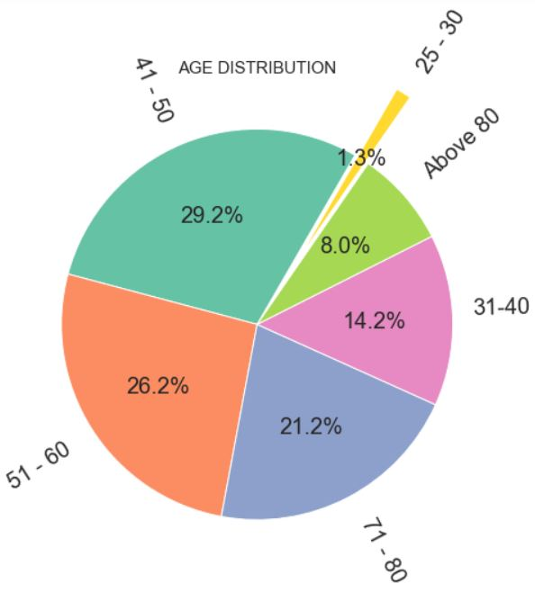
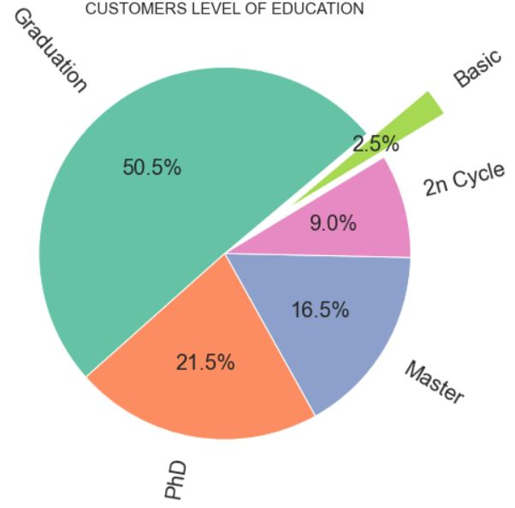
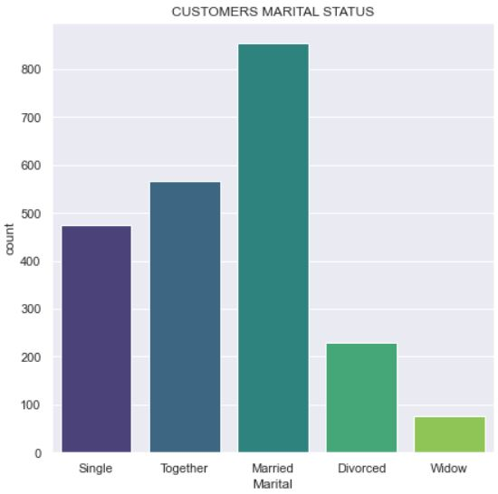
Customer Characteristic Features
A lot of the company's customer base are highly educated, married and 29.2% are between 41-50 which is the highest among the customer base

Slide 7

Customer Segmentation

Slide 8
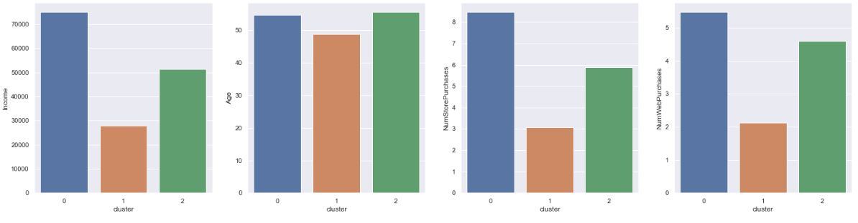
Segmentation Based on Customers Behavior
Cluster 0 (722 customers): they are high income earners, made the most product purchases, have at least one teen at home and made the most catalog and web purchases.
Cluster 1 (715 customers): low income earners, youngest amongst the three segments, have the lowest product purchases, have at least one kid at home and had the highest number of visits to the company's website.
Cluster 2 (763 customers): average income earners, oldest among the clusters, majority had no kid or teen at home and made the most purchases using a discount.

Slide 9

Classification Model

Slide 10
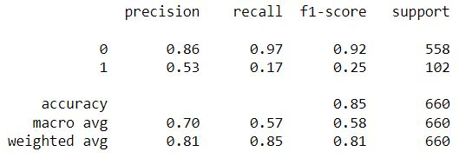
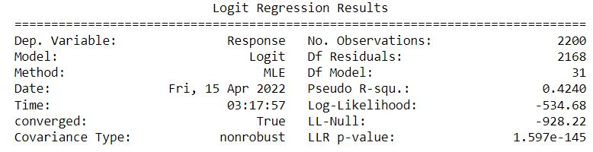
Classification Result
Logistic regression was used to predict customers that would purchase the company's offer. Also, logit model was used to check the pseudo R-squared and p-value of the data.
With an accuracy score of 0.85, The model can successfully predict 85% that a customer will respond to the company's offer. Also, a pseudo R-Squared value of 0.424 and a p-value less than 0.05 indicates that the model is an excellent fit for this data set.

